Slide 1
γp➔K⁰Σ⁺
Kyle Romines

Slide 2
Event Selection
Chose 3 pion and proton final state pπ⁺π⁻π⁰ (like γp➔pω)
Cut pπ⁰ (Σ⁺) invariant mass from 1170 to 1205 MeV
Applied MK DOCA cut to achieve better signal to background ratio as in arXiv:1302.0322
Used Q-value determination for final background subtraction

Slide 3
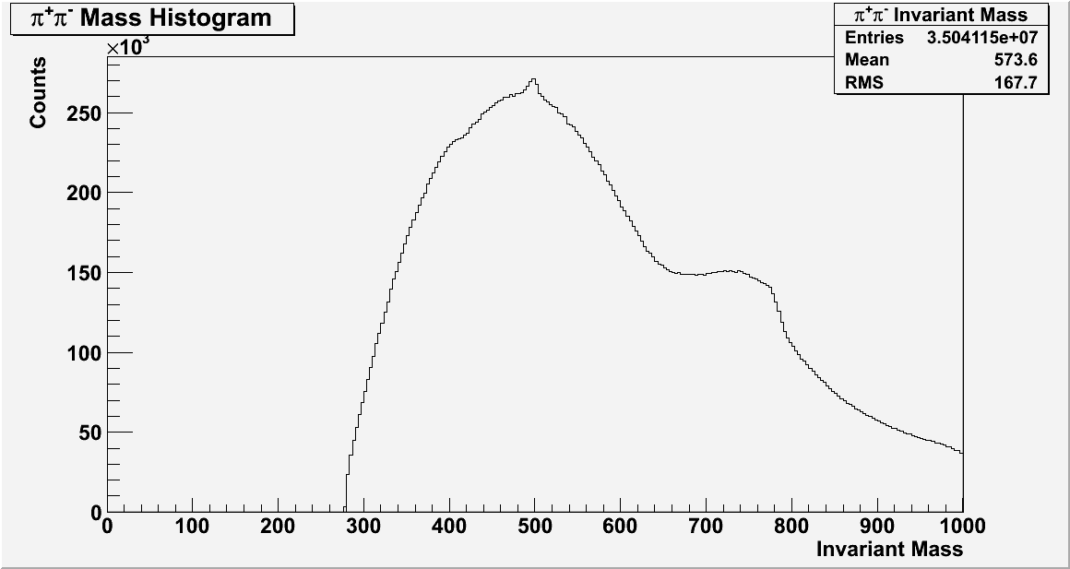

Slide 4
Event Selection
Chose 3 pion and proton final state pπ⁺π⁻π⁰ (like γp➔pω)
Cut pπ⁰ (Σ⁺) invariant mass from 1170 to 1205 MeV
Applied MK DOCA cut to achieve better signal to background ratio as in arXiv:1302.0322
Used Q-value determination for final background subtraction

Slide 5
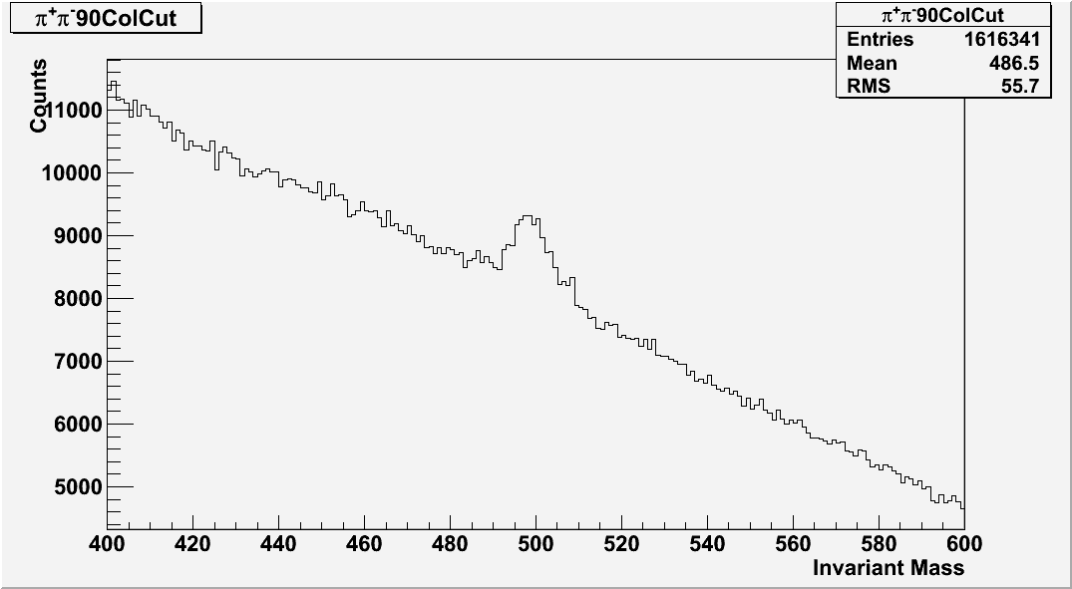

Slide 6
Event Selection
Chose 3 pion and proton final state pπ⁺π⁻π⁰ (like γp➔pω)
Cut pπ⁰ (Σ⁺) invariant mass from 1170 to 1205 MeV
Applied MK DOCA cut to achieve better signal to background ratio as in arXiv:1302.0322
Used Q-value determination for final background subtraction

Slide 7
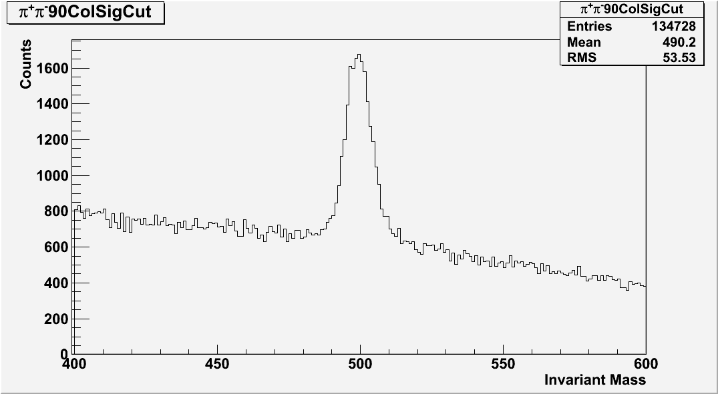

Slide 8
Event Selection
Chose 3 pion and proton final state pπ⁺π⁻π⁰ (like γp➔pω)
Cut pπ⁰ (Σ⁺) invariant mass from 1170 to 1205 MeV
Applied MK DOCA cut to achieve better signal to background ratio as in arXiv:1302.0322
Used Q-value determination for final background subtraction

Slide 9
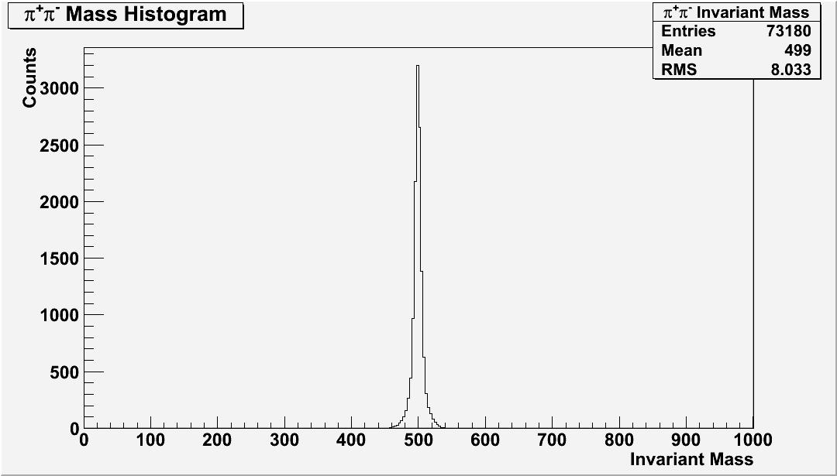

Slide 11
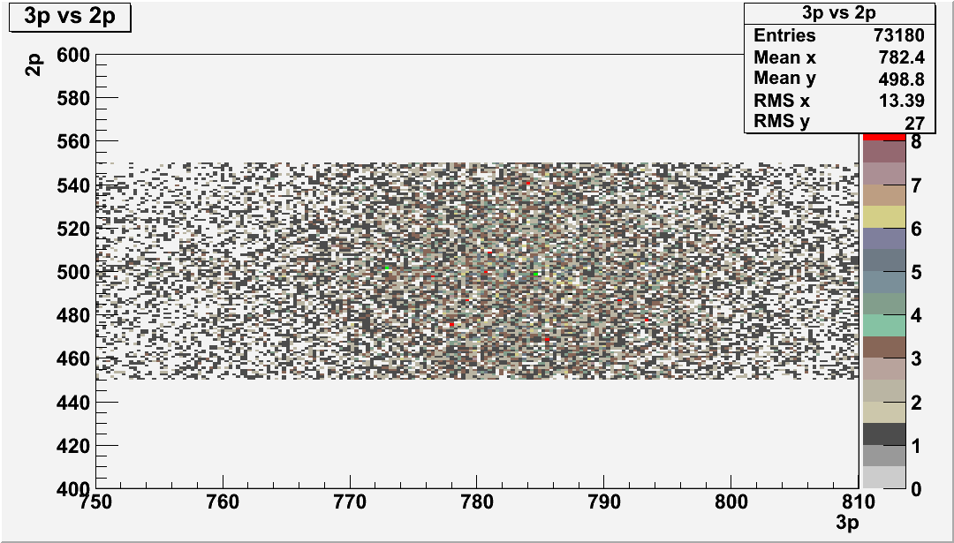

Slide 12
